Slide 1





EEE 416 - Microprocessor and Embedded System Laboratory
Jan 2021 Level-4 Term-1 Section B
Final Project Demonstration
Microcontroller Based Digital Over Voltage Protection System for Industrial Loads
Submitted by – Group B1.05
Azad Rahman
1606088
Abir Kallayan Abedin
1606091
Swapnil Saha
1606095
Muhammad Sameen
Uddin Mashuk
1606098
Department of Electrical and Electronics Engineering
Bangladesh University of Engineering and Technology

Slide 2
Outline
Summary
Background
Methodology
Algorithm and Flowchart
Circuit Components: Sensors and Protection
Circuit Components: Source, Voltage Step-Down and Rectifiers
PCB Layout and 3d rendering
Overvoltage Protection System: Using Intel 8086 – Circuit Components
Overvoltage Protection System: Using Intel 8086 – PCB Layout and 3D Rendering
Future Outlook
Conclusion

Slide 3
Summary
The project designed, focuses on the protection of a 3-phase power system in the event of an voltage overload. In industrial power applications, overvoltage is a serious concern that needs to be addressed quite quickly in order to minimize damage. Our project focuses on the implementation of such as a system, that will protect industrial equipment in an over-voltage condition. Based on some necessary assumptions, restrictions and industry-grade emulation, we designed a micro-controller based system to successfully carry out our objectives.

Slide 4
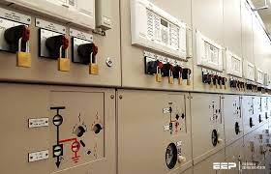
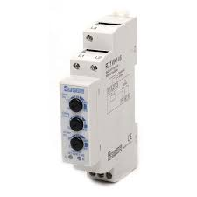
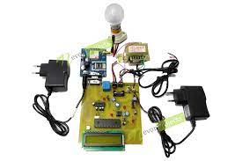
Background
Industrial Reliability
Protect Electronic component
Ensure Safe Shutdown
Figure: Protection of Industrial Systems
Figure: MCU-based Overvoltage Load Protection System
Figure: Overvoltage Relay

Slide 5
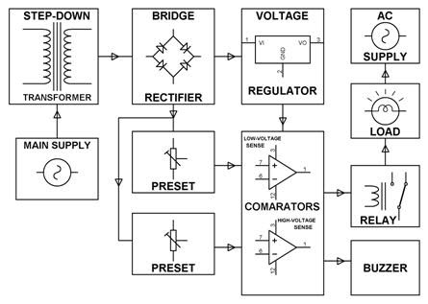
Methodology
A standard method to expand a high voltage tripping mechanism to protect the industrial load from the damage
Distinguishing between normal voltage fluctuation and harmful overvoltage fluctuation
Prevention of excess voltage from being applied to the component
Figure: Industry Grade High-Voltage Protection System

Slide 6
Algorithm and Flowchart
NO
Voltage > Threshold
Measure Voltage Source
YES
Check Voltage
Still High
NO
YES
Nominal Source Voltage 220V
Max Source Voltage 300V
Operating Frequency 50 Hz
Decouple Load from Source

Slide 7
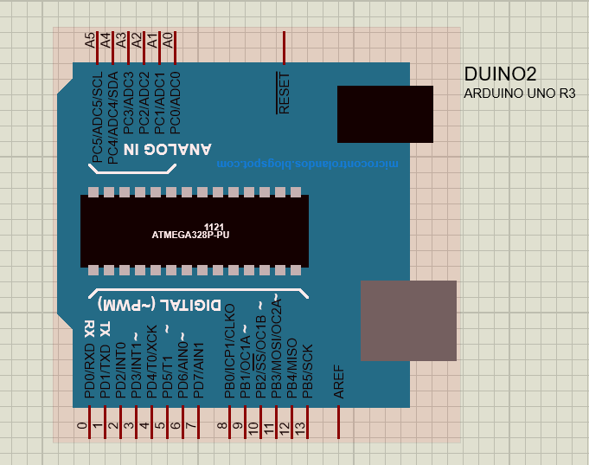
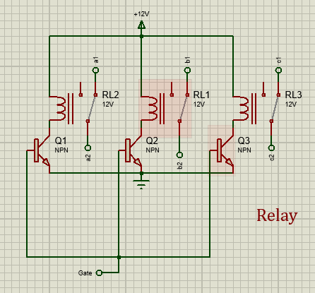
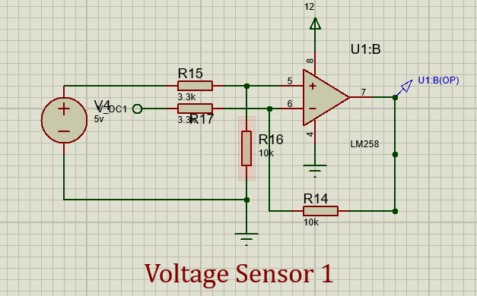
Circuit Components:
Sensors and Protection
Arduino UNO
Relay Block
Voltage Sensor Block
Figure: Microcontroller Block – Arduino Uno
Figure: Relay Block
Figure: Voltage Sensor Block

Slide 8
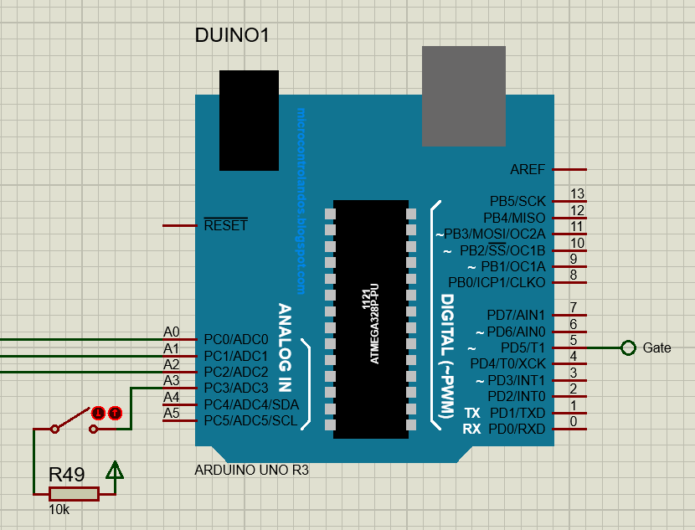
Circuit Components:
Sensors and Protection
Arduino UNO
Voltage reading from ‘Voltage Sensor Block’ in Analog Mode (Port A0, A1, A2)
Conversion into actual voltage value
Comparison with predefined threshold voltage
High voltage occurrence → Give signal to ‘Port Gate’
Port A3 for manual restart
Figure: Microcontroller Block – Arduino Uno

Slide 9
Circuit Components:
Sensors and Protection
Relay Block
Input → Gate signal from Arduino
Three relays used to isolate three voltage source
With no Gate signal, relay is in closed contact
Gate signal → npn transistor, path is energized the relay
Energized relay – Isolation of the load from source
Figure: Relay Block

Slide 10
Circuit Components:
Sensors and Protection
Voltage Sensor Block
Op-Amp based Voltage Sensor
Negative Comparators
One for each of the 3 phases
Reference Voltage → 5 Volts
Output → To the Microcontroller Unit
Figure: Voltage Sensor Block

Slide 11
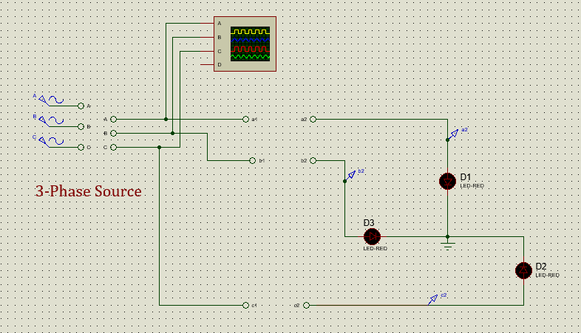
Circuit Components:
Source, Voltage Step-down
and Rectifiers
3-Phase Source
Main voltage source – An ideal 3-phase source
Source Specifications:
Nominal Source Voltage 220V
Max Source Voltage 300V
Operating Frequency 50 Hz
Figure: 3-Phase Source

Slide 12
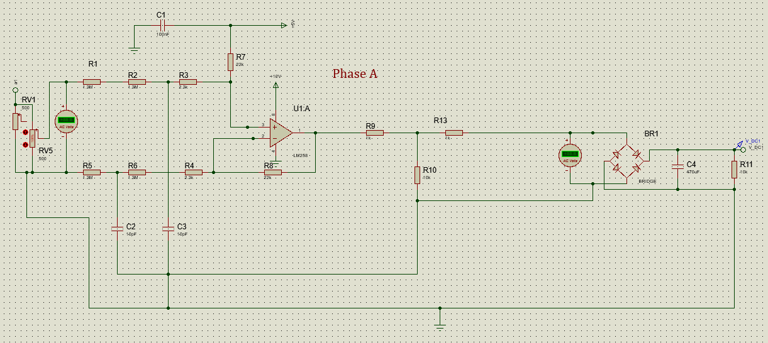
Circuit Components:
Source, Voltage Step-down
and Rectifiers
Voltage Step-down and Rectification
Step-down of Source Voltage for each phase
Step-Down Circuit → Use of Op-Amp
Voltage Rectification → AC Components to DC
Full-Bridge Rectifier
Figure: Voltage Step-down and Rectification

Slide 13
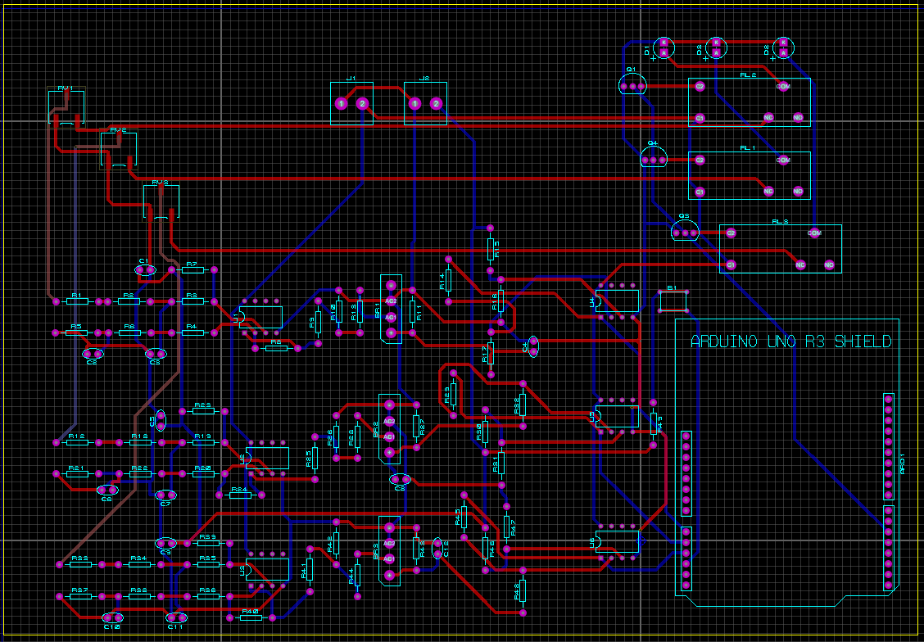
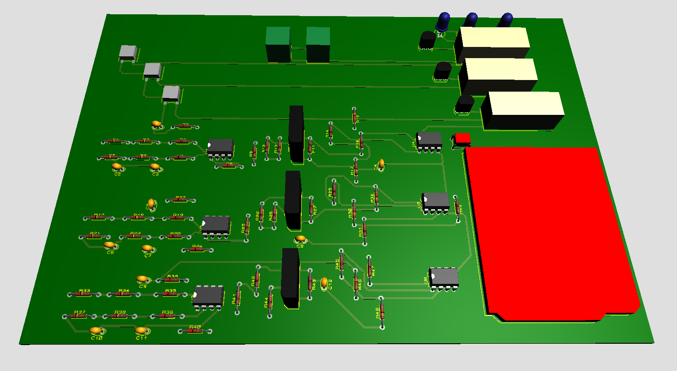
PCB Layout and 3D Rendering:
Figure: PCB Layout
Figure: 3D Rendering of PCB Layout

Slide 14
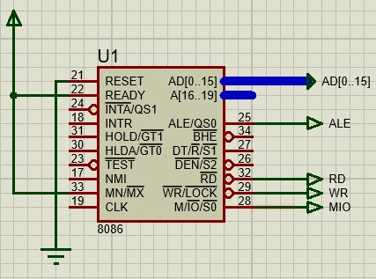
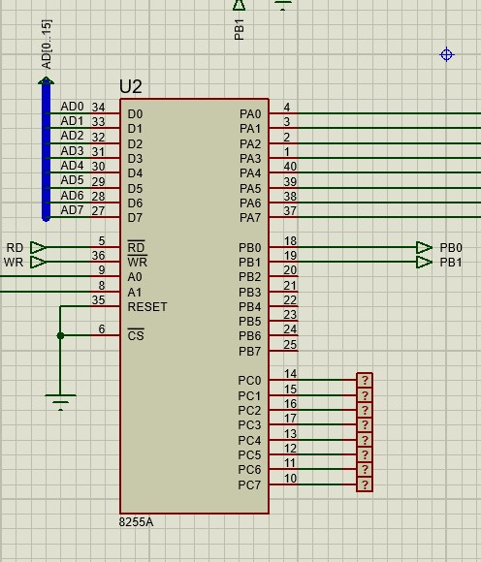
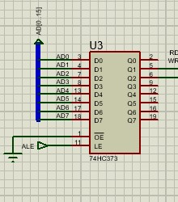
Overvoltage Protection System: Using Intel 8086
Circuit Components:
Intel 8086 Microprocessor
Used to read values of voltage from the 82555
Programs the device to get disconnected when voltage is over the threshold value
Figure: 8086 Block
8255A PPI
Takes input value from the ADC0804 PORTA, PORTB, PORTC programmed as input port, output port and output port respectively
Address Latch
Figure: 8255A PPI
Helps to execute the IN and OUT commands
Figure: Address Latch

Slide 15
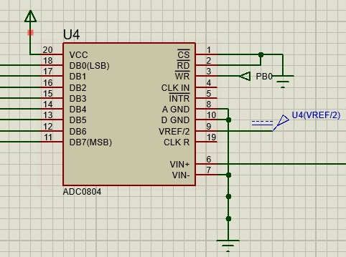
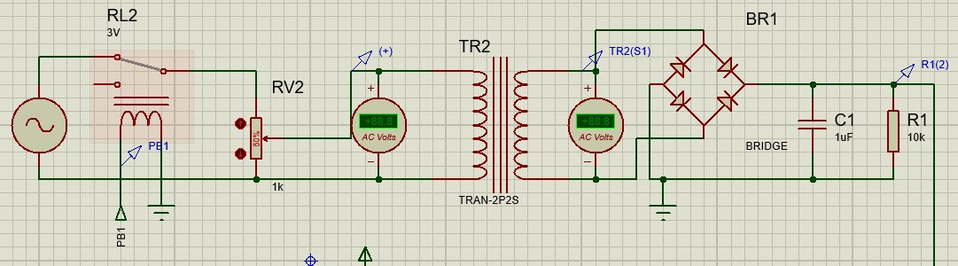
Overvoltage Protection System: Using Intel 8086
Circuit Components:
ADC0804
Converts the analog voltage value to 8-bit binary value as there is no built-in ADC in 8086
Vref/2 set to half of Vin+
Figure: ADC0804
Voltage Step-down and Rectification
Steps Down the AC voltage with turns ratio of 5:311
Rectifies the stepped down voltage through the diode bridge and feeds it to the Vin+ pin of ADC
Figure: Voltage Step-down and Rectification

Slide 16
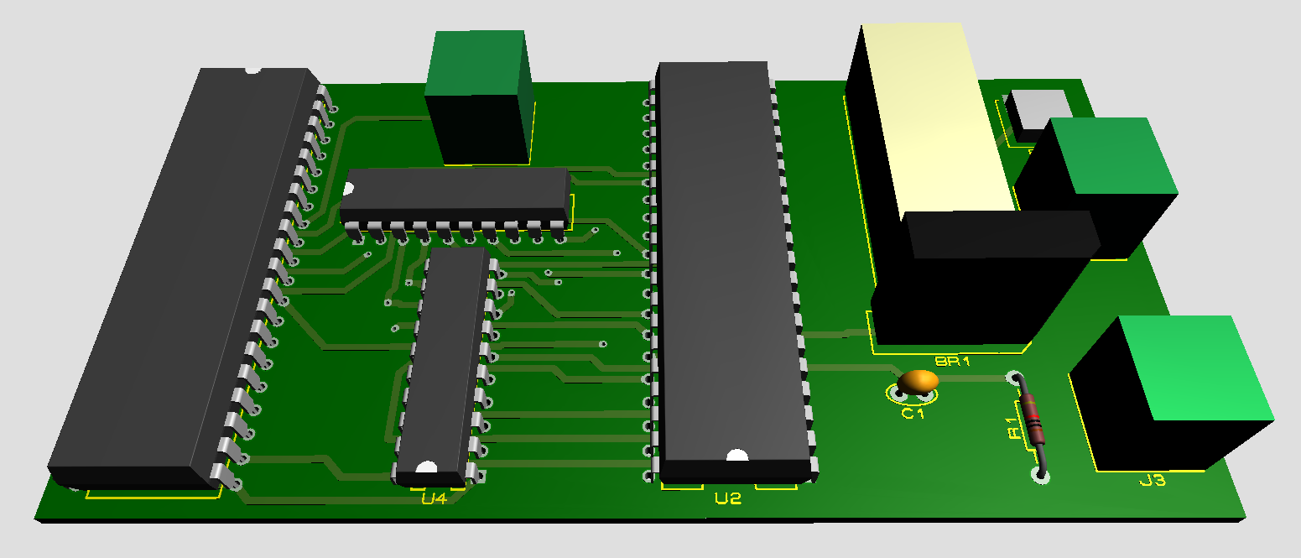
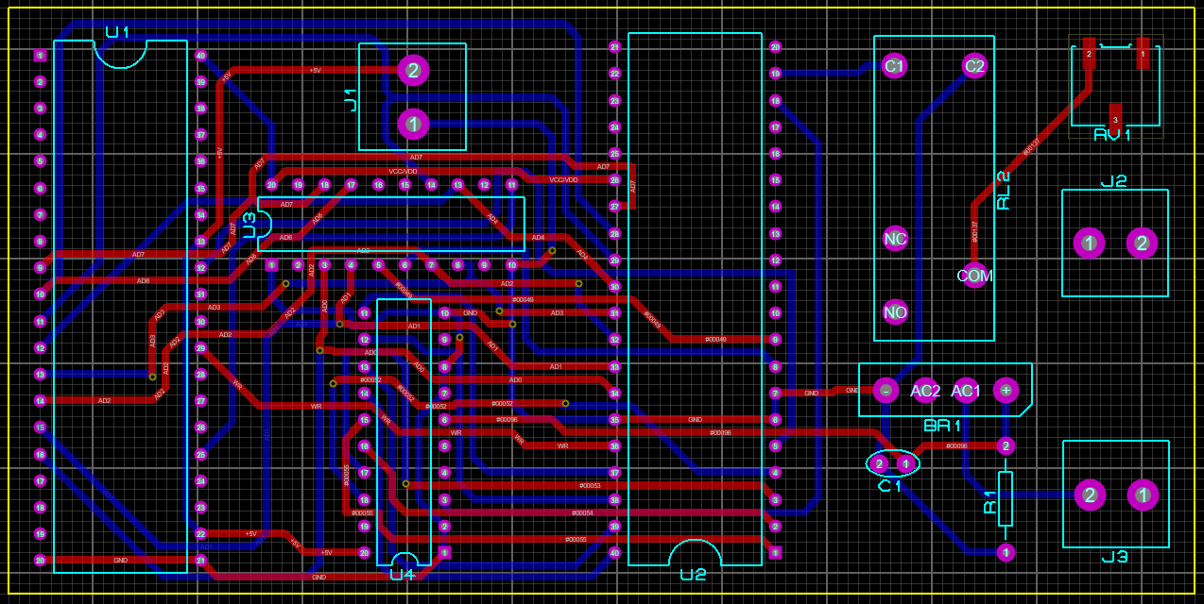
Overvoltage Protection System: Using Intel 8086
PCB Layout and 3D Rendering:
Figure: PCB Layout
Figure: 3D Rendering of PCB Layout

Slide 17
Future Outlook:
Some of the aspects of the system designed can be improved based on the application.
The source voltage range can be varied over a larger range to emulate the source as used in the industries.
The voltage step-down, the rectification of the source voltage can be implemented using more efficient strategies.
Voltage sensors can be improved based on more sensitivity to minute changes.
Based on the modern industrial systems, a better protection scheme with circuit breakers, along with relays, can be implemented.

Slide 18
Conclusion:
The operation of relay takes place in fraction of seconds without any delay and the relay is operated even for small changes in the operating voltage and hence it is more reliable.
System responds properly when the voltage exceeds a predefined threshold. The system can be made more versatile if the under-voltage protection scheme is also introduced in the system.
Manual re-establishment of the connection ensures that the circuit does not operate due to any fault while in overvoltage condition.

Slide 19
Additional Slides
Microcontroller Based Digital Over Voltage Protection System for Industrial Loads
Submitted by – Group B1.05

Slide 20
References:
P. Anwitha, S. S. Yalamareddy, “Overload Protection using Microprocessor based Overvoltage Relay: Proteus Simulation,” International Journal of Engineering Research & Technology (IJERT), Vol. 5 Issue 11, November-2016.
K. P. Kpochi, E. J. Smith, A. A. Ibrahim, “Microcontroller-based under and over voltage protection device,” American Journal of Engineering Research (AJER), Volume-7, Issue-8, pp-16-20, 2018
https://microcontrollerslab.com/smart-voltage-protection-system-home/

Slide 21
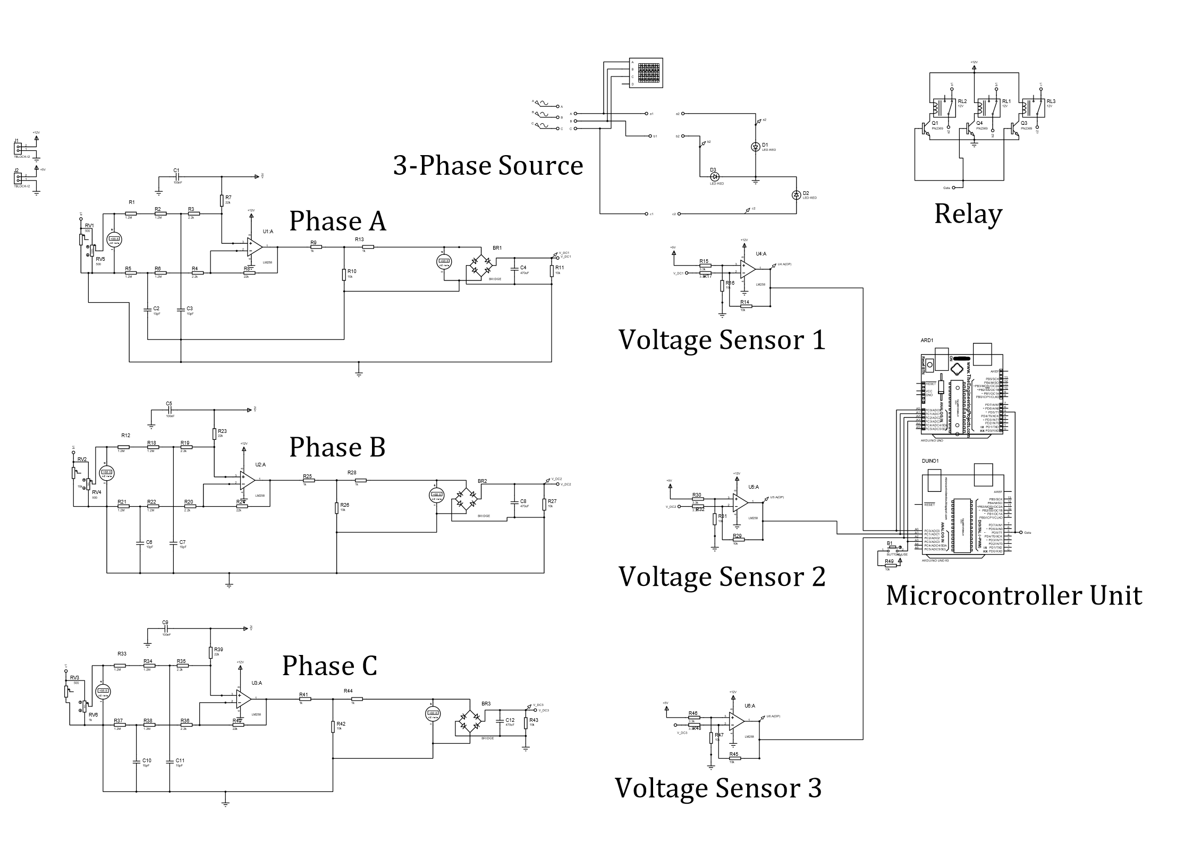
Circuit Diagram:
Figure: Circuit Diagram of the Over-Voltage protection System

Slide 22
Source Codes:
if ((voltagea < 3)) {
//digitalWrite(control, HIGH);
counta = counta + 1UL;
if (counta > count) {
digitalWrite(control, HIGH);
}
}
else if ((voltageb < 3)) {
//digitalWrite(control, HIGH);
countb = countb + 1UL;
if (countb > count) {
digitalWrite(control, HIGH);
}
}
else if ((voltagec < 3)) {
//digitalWrite(control, HIGH);
countc = (countc + 1UL);
if (countc > count) {
digitalWrite(control, HIGH);
}
}
else
{
int s = analogRead(A3);
//Serial.println(s);
Serial.println("............");
if (s == 1023)
{
digitalWrite(control, LOW);
counta = 0;
countb = 0;
countc = 0;
}
}
}
// EEE 416_J2021_Group B1.05
// the setup routine runs once when you press reset:
int control = 5;
//For delay
unsigned long counta = 0;
unsigned long countb = 0;
unsigned long countc = 0;
unsigned long count = 9600; // 6sec*16Mhz =96M
void setup() {
// initialize serial communication at 9600 bits per second:
Serial.begin(9600);
pinMode(control, OUTPUT);
digitalWrite(control, LOW);
delay(3000); // Delay at starting
}
// the loop routine runs over and over again forever:
void loop() {
// read the input on analog pin 0:
int sensorValuea = analogRead(A0);
int sensorValueb = analogRead(A1);
int sensorValuec = analogRead(A2);
// Convert the analog reading (which goes from 0 - 1023) to a voltage (0 - 5V):
float voltagea = sensorValuea * (5.0 / 1023.0);
float voltageb = sensorValueb * (5.0 / 1023.0);
float voltagec = sensorValuec * (5.0 / 1023.0);

Slide 23
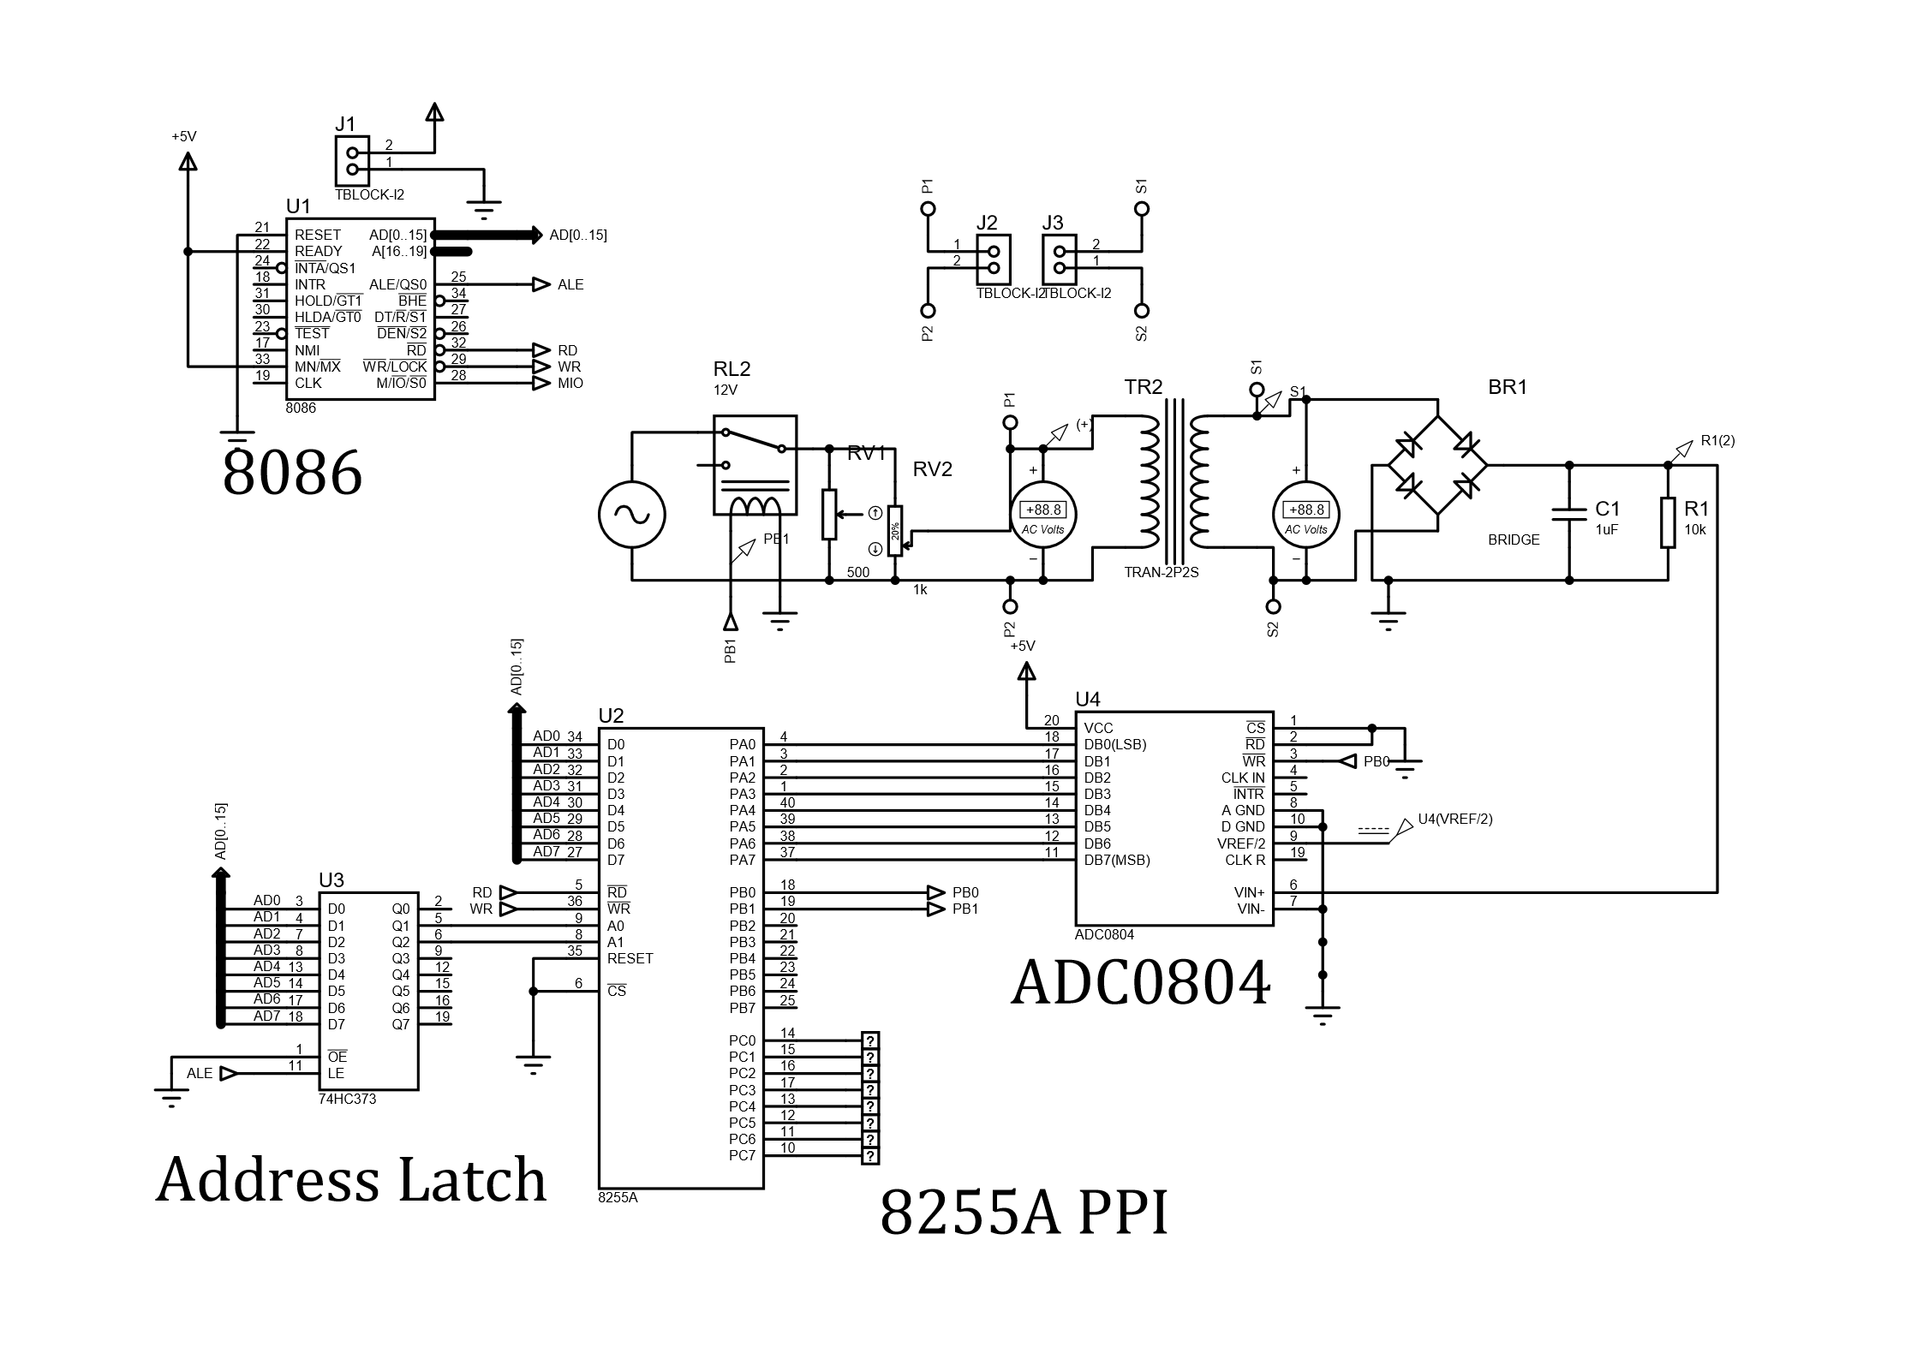
Overvoltage Protection System: Using Intel 8086
Circuit Diagram:
Figure: Circuit Diagram of the Over-Voltage protection System using Intel 8086

Slide 24
Overvoltage Protection System: Using Intel 8086
Source Codes:
;Over Voltage Protection using 8086
DATA SEGMENT
PORTA EQU 00H ;address declaration
PORTB EQU 02H ;of 8255A ports
PORTC EQU 04H
PORT_CON EQU 06H
DATA ENDS
CODE SEGMENT
MOV AX,DATA
MOV DS, AX
ORG 0000H
START:
MOV DX, PORT_CON ;declaring the ports
MOV AL, 10010000B ;as inputs(A) and
OUT DX, AL ;outputs(B and C)
MOV AL,00H
XX:
CMP AL, 00000011B
JE XX
IN AL,PORTA
CMP AL, 11100000B ;checks if the voltage
JA D5 ;is greater or less
JBE D4 ;than rms 224V
D4: ;if <224V do nothing
OUT PORTC,AL ;and display the value in
MOV DX, PORTB ;portC
MOV AL, 00000000B
OUT DX,AL
MOV CX, 0FFH ;delay
D1:
LOOP D1
MOV DX, PORTB
MOV AL, 00000001B
OUT DX,AL
JMP D3
D5: ;if >224V disconnect
OUT PORTC,AL ;the circuit by energizing
MOV DX, PORTB ;the relay through portB
MOV AL, 00000010B
OUT DX,AL
MOV CX, 0FFH
D7:
LOOP D7
MOV DX, PORTB
MOV AL, 00000011B
OUT DX,AL
D3:
MOV CX, 0FFH
D2:
LOOP D2
JMP XX
CODE ENDS
END

Slide 25
Difficulties:
The project done using Proteus 8.6, which did not fully comply while running the simulation in real-time.
The input voltage had to be kept within a certain range in order for the voltage sensor to read the voltage properly.
While creating the PCB layout for the design, some of the components did not contain PCB packages, and the correct model was quite difficult to find for Proteus 8.6.
Certain restraints had to be taken while simulating the model of an industrial load.

